Slide 1
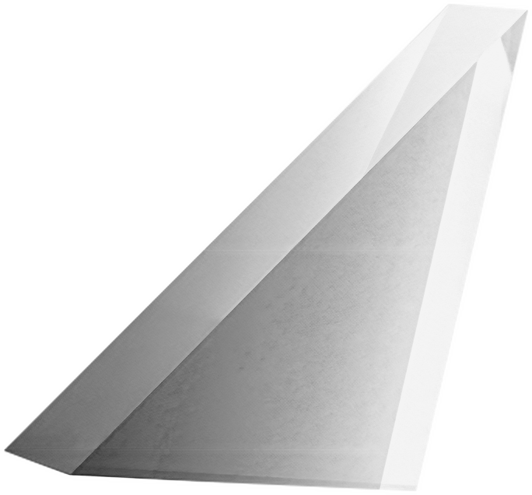
GLS University
RETINASENSE - AI
Intelligent Diabetic Retinopathy Detection System
Department of Computer Applications
MCA Capstone Project : 2026–27
Developed By :
Lathiya Harshal
Kothari Srusthi
Koradiya Vidhi
Kotecha Vansh
Kalaria Jug
Guided by : DR. PRERNA AGRAWAL

Slide 2
INTRODUCTION
  What Is Diabetic Retinopathy?
  Diabetic Retinopathy (DR) is a diabetes-related eye condition in which elevated blood glucose can damage the blood vessels of the retina, the light-sensitive tissue at the back of the eye.
  Our system aims :
  To classify retinal fundus images into predefined DR severity categories and provide an accompanying visual explanation.

Slide 3
PROJECT DEFINITION
WHAT IS RETINASENSE AI?
  It is an Intelligent Diabetic Retinopathy Detection System is a proposed web-based AI application that analyzes retinal fundus photographs using computer vision and deep learning to classify diabetic retinopathy severity.
  The system combines image preprocessing, trained-model inference, probability outputs, and Grad-CAM-based visualization in one application.

Slide 4
EXPECTED INPUT & OUTPUT
Input : A retinal fundus image in a supported image format.
Class | Category
0 | No DR
1 | Mild DR
2 | Moderate DR
3 | Severe DR
4 | Proliferative DR
Deep Learning + Explainable AI
Image preprocessing, severity prediction and Grad-CAM generation
Expected Output : A retinal fundus image in a supported image format
  Predicted DR severity category
  Class probabilities and confidence information
  Grad-CAM heatmap and overlay visualization

Slide 5
PROJECT PROFILE
Project Title | RetinaSense AI – Intelligent Diabetic Retinopathy Detection System
Project Type | Capstone Project 1
Domain | AI / ML
Subdomain | Medical Image Analysis
Application Type | Web-Based AI Digital Platform
Primary Input | Retinal fundus photograph
Explainability Approach | Grad-CAM

Slide 6
TOOLS & TECHNOLOGIES
AI and Deep Learning | AI and Deep Learning
Frontend Development | React.js,Tailwind CSS
Backend Development | Python, FastAPI, REST APIs
Database | PostgreSQL
Development & Testing | Git, GitHub, Postman, VS Code, Jupyter Notebook,

Slide 7

SYSTEM MODULES
RetinaSense AI
Admin
Module
User
Module
Radiologist Module

Slide 8

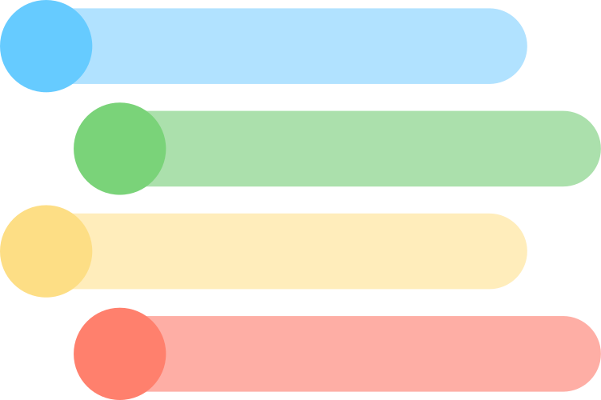


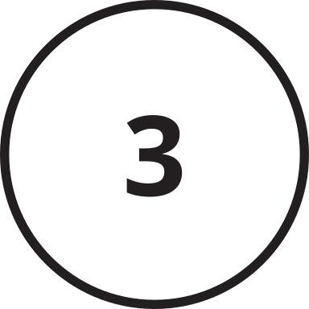
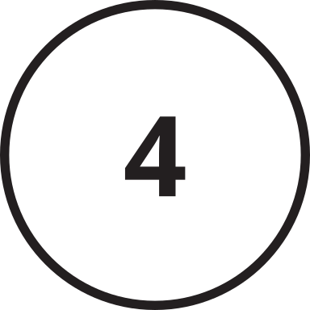
MODULES WITH FEATURES
Admin Module
User Module
Rediologist Module
Admin login
User registration and login
Radiologist Login
Dashboard & system statistics
User dashboard
Verify Images
User management
Retinal image upload
DR severity prediction
Prediction record monitoring
Prediction results and history
Final Analysis Submit

Slide 9

SYSTEM FUNCTIONALITIES
Admin Module
Secure access to the administration dashboard.
Admin login
View an overview of system activity and usage.
Dashboard & system statistics
User management
View, manage, and control registered user accounts.
Monitor image-analysis records and generated Al predictions.
Prediction record monitoring

Slide 10
SYSTEM FUNCTIONALITIES
User Module
Create an account and securely access the system.
User registration and login
Access image analysis and previous results.
User dashboard
Retinal image upload
Upload a retinal fundus image for AI analysis.
View predicted DR severity, class probabilities, Grad-CAM visualizations, and previous analysis records.
Prediction results and history

Slide 11
SYSTEM FUNCTIONALITIES
Rediologist Module
Secure access to the radiologist dashboard.
Radiologist Login
Review uploaded retinal images for quality, clarity, and suitability for analysis.
Verify Images
Review the AI-generated severity category, probabilities, and visual explanation.
DR severity prediction
Final Analysis Submit
Submit the radiologist's final assessment and save the reviewed result.

Slide 12
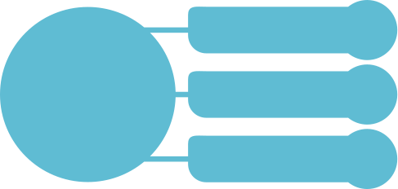
USERS OF THE SYSTEM
Administrator
RetinaSense AI
Registered User
Radiologist

Slide 13
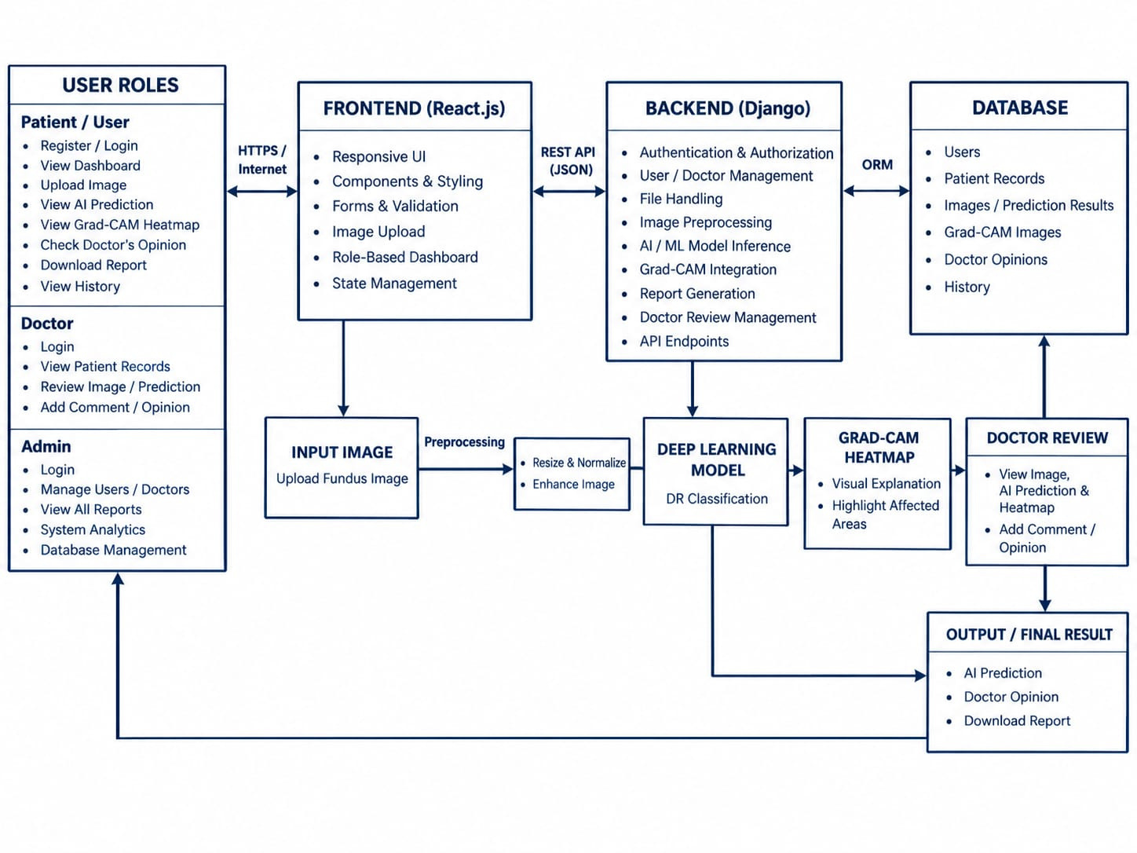
SYSTEM ARCHITECTURE DIAGRAM

Slide 14
THANK YOU !

